Slide 1
Fitting Fitness In
Be consistent
Get creative
Get everyone on board!

Slide 2
Take Care of Yourself FIRST!
Are you ready?
Schedule your fitness
10 minute bouts of exercise
Take Small Steps for BIG results
Positive self talk
It’s not easy but it’s worth it
It takes 6 weeks to develop a habit
We have to change the way we think before we can change what we do. Take control of you!

Slide 3
Reasons to Exercise
Improved memory and concentration
Improved mood
Lower levels of stress
Temporary relief from depression and anxiety
Build strength in your body, your heart and lungs
Increased bone density
Reduce risk of heart disease – live longer
Weight Loss
Better balance and sleep
Increase confidence
Perform better
Your energy boost during your day benefits everyone
When you feel good you go out and do GREAT things!

Slide 4
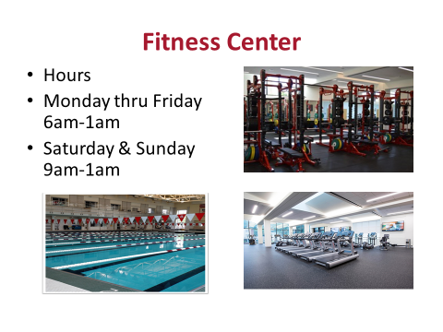
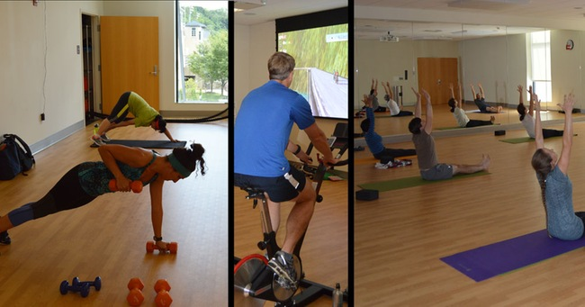
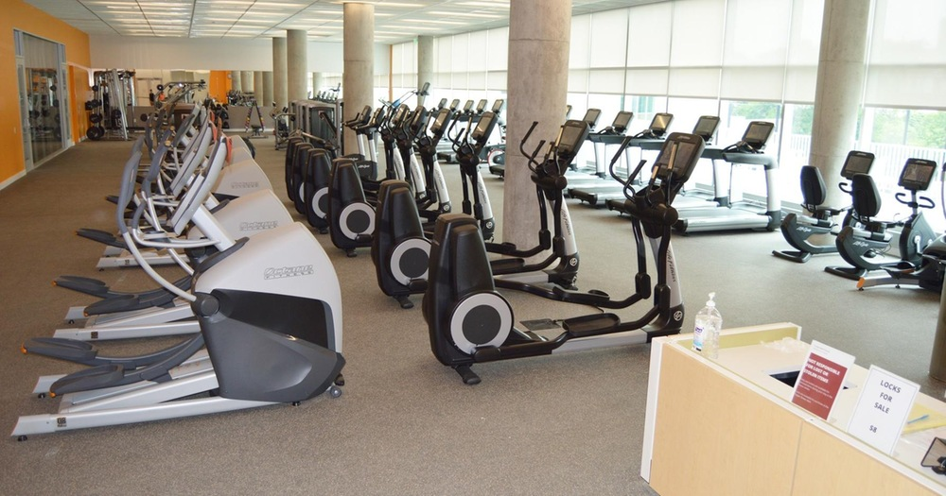
Equipment:
Cardio Machines
Synergy 360
Free Weights
Expresso Bikes
Services:
Lockers
Towel
Laundry
Racquet
Family & Friends:
Guest policy
Studios:
Studio A
Indoor Cycling Studio
Spivi System
Keeler Studio
Noll Studio

Slide 5
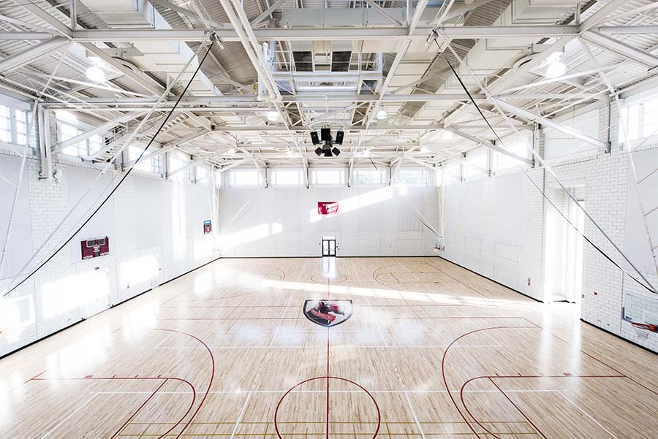
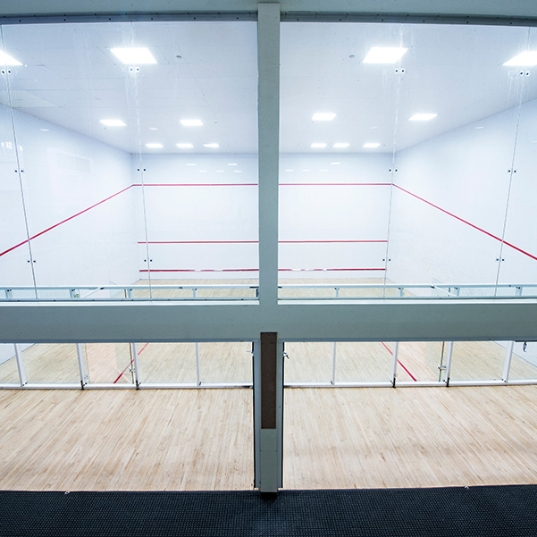
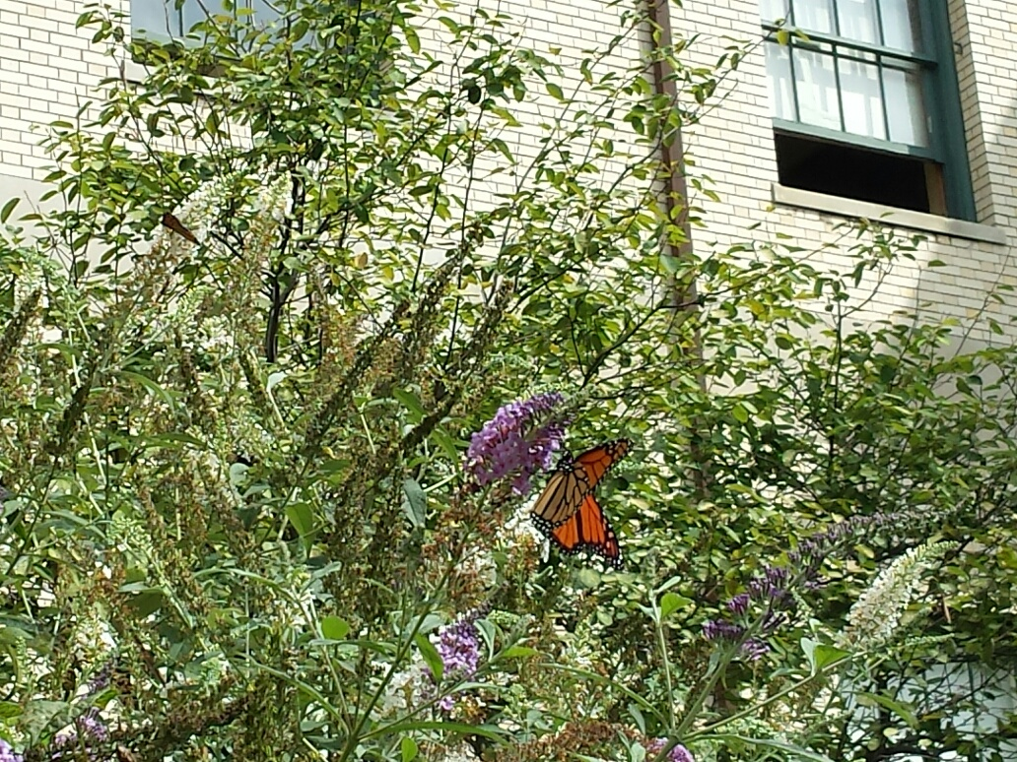
Resources on Campus
Fitness Center - http://athletics.cmu.edu/fitness/index
Tepper Fitness Center - http://athletics.cmu.edu/facilities/tepperfitness
Group X Classes & Studios - http://athletics.cmu.edu/fitness/groupx
Group X On Demand - http://athletics.cmu.edu/fitness/ondemand
Courts – Basketball, Volleyball, Badminton, Racquetball, Squash & Tennis
Aquatics – Lap Pool & Dive Pool
Personal Trainers – 10 Nationally Certified Trainers
Mellon FIT - http://mellonfit.weebly.com/
Green Roofs - https://www.cmu.edu/environment/campus-green-design/green-roofs/
Butterfly Garden
Nature Walk behind Gates to the Cut
Fitness Center above the Carnegie Mellon Café

Slide 6
Excuses? We all have one
You can handle the ups and downs with a calm breath
Don’t give up – this is your choice
It doesn’t have to be Monday
5 Minutes of extra movement can add to a more active lifestyle
If you cheat or miss – get back on track!
Think Healthy, Be Healthy!
Be Positive!
Balance and Well Being are the foundations to a healthy, happy life!

Slide 7
Healthy Choices
Do I need it?
Is it worth it?
Am I hungry?
Maybe I am just thirsty?
Calorie expenditure vs Calorie intake
Carry healthy snacks with you
Just because it’s FREE doesn’t mean you have to eat it
Take a bite or a sliver not the whole piece
Write down what you eat – use an app – Lose It! - Fooducate

Slide 8
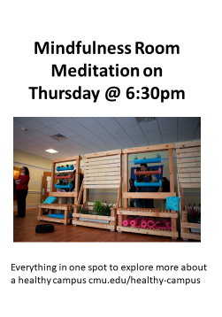
STRESSED
STRESSED
FREE subscription to Headspace for faculty and staff. Use your andrew and sign up
https://www.headspace.com/cmu
Guided Meditations - http://marc.ucla.edu/mindful-meditations
Campus Wellness - https://www.cmu.edu/wellness/be-mindful/mindfulness-downloads/index.html
Mindfulness Room - https://www.cmu.edu/wellness/be-mindful/mindfulness/
FREE Faculty Staff Meditation Classes
Tuesday Noon-12:30 in the Activities Room on the second floor of the Cohon University Center

Slide 9
Chair Exercises
Head
Shoulders
Arms
Waist
Twist
Reach
Side Bend
Figure 4
Leg Lifts
Stretch

Slide 10
Set Your Priorities
Have you neglected taking care of yourself?
Take a workation that includes leaving the building
Schedule a walking meeting
Stay motivated
Health is the most precious quality we can wish for
Increase your quality of life
Add years on your life

Slide 11
What is the best exercise to do?
Track Your Activity
Change it Up
FITT Principles
Train for Life

